Slide 1
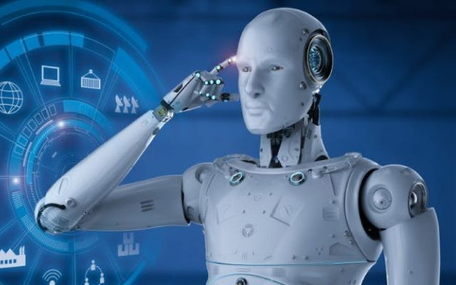
Group 7
ITAI 1378
Professor Patricia McManus
The Evolution of Computer Vision
Computer vision has advanced rapidly since the 1990s. Key developments include SLAM, SIFT, deep learning, and multimodal AI. This timeline highlights major milestones that shaped the field.

Slide 2
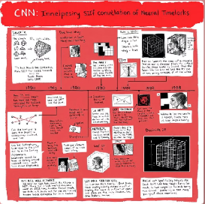
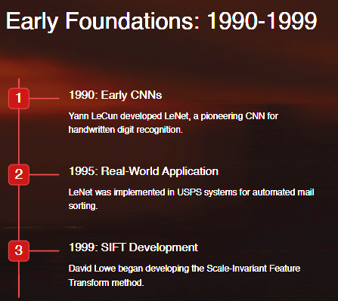

Slide 3
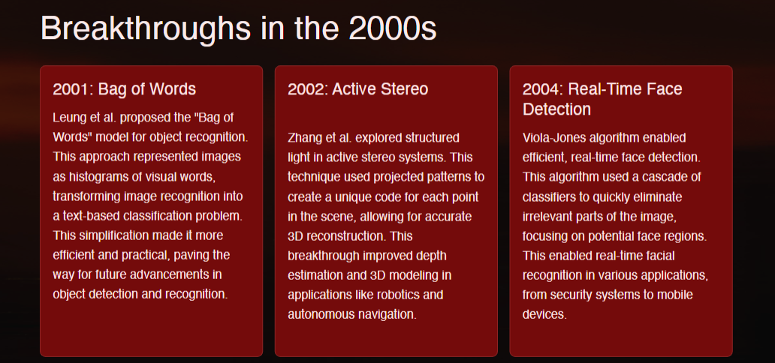

Slide 4
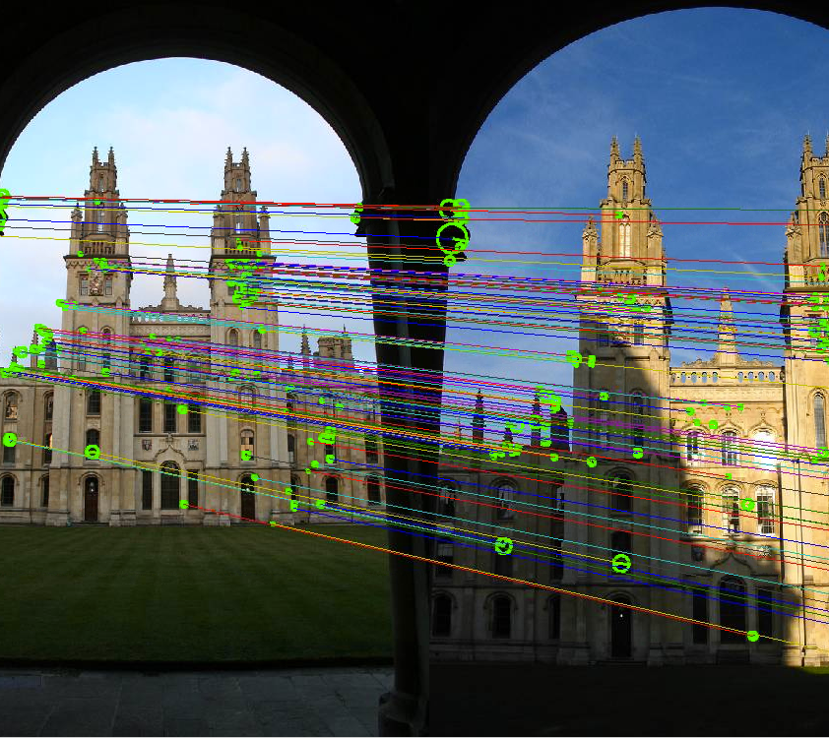
SIFT and Its Impact
David Lowe formally introduced SIFT in his 2004 paper titled "Distinctive Image Features from Scale-Invariant Key points." This method meticulously located key points within an image and calculated unique descriptors for each, capturing local image patterns while being resilient to changes in scale, rotation, and illumination. SIFT quickly became a cornerstone in the field of computer vision, influencing a wide range of applications, including object recognition, image stitching, and 3D modeling.

Slide 5
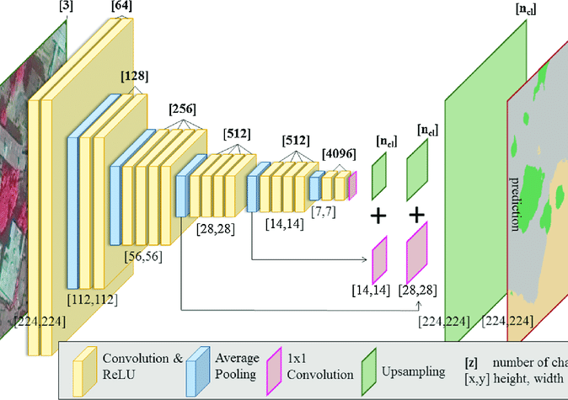
The Deep Learning Revolution
2012
AlexNet
Alex Krizhevsky, Ilya Sutskever, and Geoffrey Hinton created the AlexNet, which won the ImageNet competition by a large margin, igniting the deep learning revolution in computer vision.
2013
R-CNN (Region-Based Convolutional Neural Networks)
Ross Girshick, Jeff Donahue, Trevor Darrell, and Jitendra Malik iIntroduced R-CNN, which advanced object detection by combining CNNs with region proposals, significantly improving detection accuracy.
2014
VGGNet
Karen Simonyan and Andrew Zisserman (Visual Geometry Group, Oxford) development of VGGNet, which demonstrated that deep networks with very small (3x3) convolution filters could significantly improve image classification performance.
2015
ResNet (Residual Networks)
Contributors: Kaiming He, Xiangyu Zhang, Shaoqing Ren, and Jian Sun introducted ResNet, a very deep neural network that overcame the vanishing gradient problem with residual connections, enabling the training of networks with over 100 layers.

Slide 6
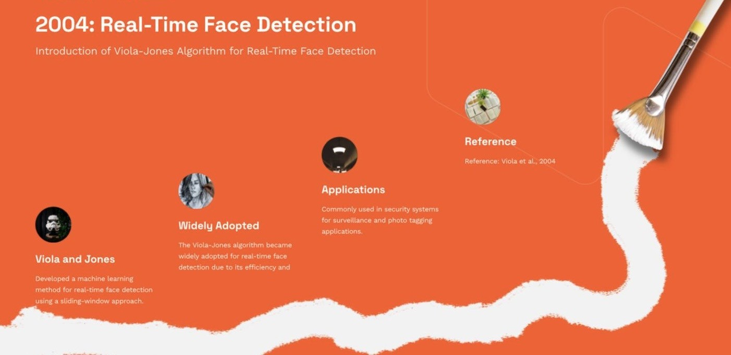

Slide 7
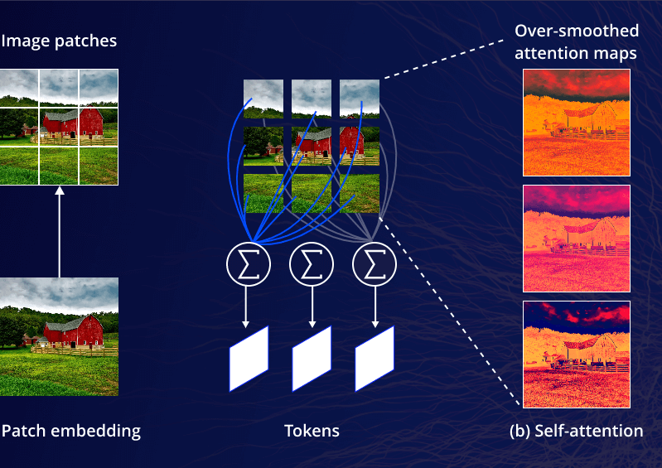
Advanced Architecture
2015
YOLO (You Only Look Once)
Joseph Redmon, Santosh Divvala, Ross Girshick, and Ali Farhadi developed YOLO, a real-time object detection system that frames detection as a single regression problem, significantly increasing detection speed.
2017
Mask R-CNN
Kaiming He, Georgia Gkioxari, Piotr Dollar, and Ross Girshick introduced Mask R-CNN, which extended Faster R-CNN to support pixel-wise object segmentation, enabling more precise object detection and segmentation.
2017
Vision Transformers (ViTs)
Alexey Dosovitskiy and colleagues at Google Research adapted transformer models for vision tasks, leading to Vision Transformers (ViTs) that rivaled CNNs in image classification performance.
2018
Generative Adversarial Networks (GANs)
Although introduced in 2014, GANs gained widespread attention in 2018, revolutionizing image generation, style transfer, and synthesis due to efforts of Ian Goodfellow
2019
EfficientNet
Mingxing Tan and Quoc V. Le introduced EfficientNet, a model that scales CNNs in a more principled manner, achieving state-of-the-art accuracy with fewer parameters and computational resources.

Slide 8
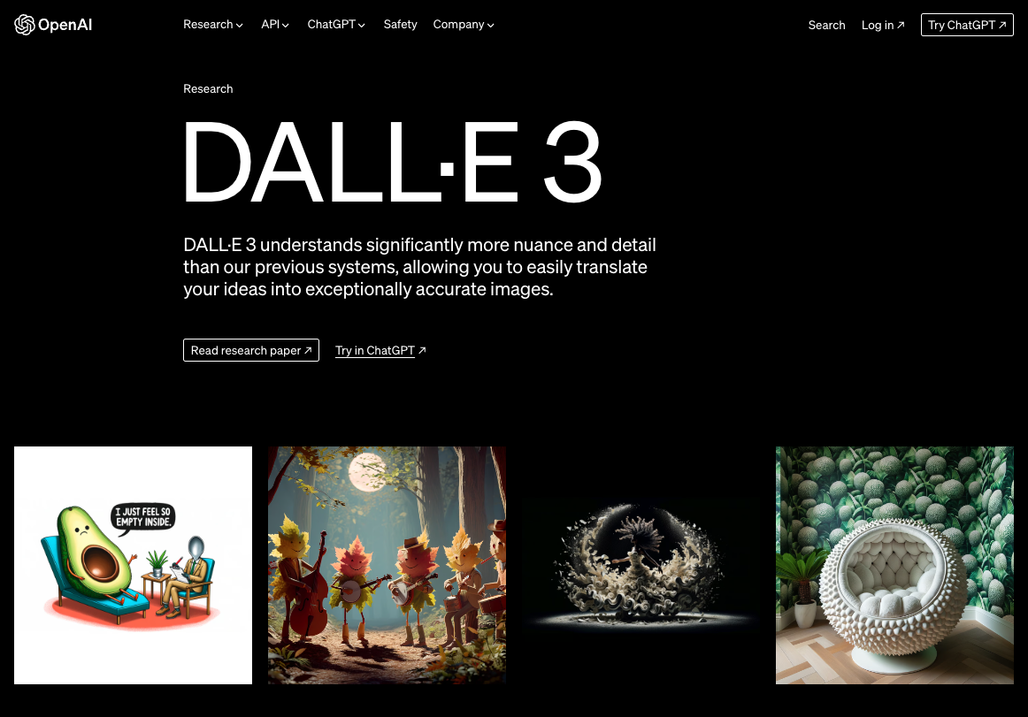
2021
DALL·E and CLIP
Contributors: OpenAI Team introduced DALL·E, a model capable of generating images from textual descriptions, and CLIP, a model that can understand and associate images and text in a highly versatile manner.
2022
Stable Diffusion
CompVis, Stability AI, and LAION developed Stable Diffusion, an open-source latent diffusion model for generating high-quality images from text prompts, making text-to-image generation widely accessible.
2023
Segment Anything Model (SAM)
Meta AI Research has introduced SAM, a model capable of segmenting objects in images and videos automatically, even for objects it wasn't explicitly trained on, marking a step forward in generalized image segmentation.

Slide 9
